Slide 1
THE LIFE OF CHRIST
PART 17

Slide 2
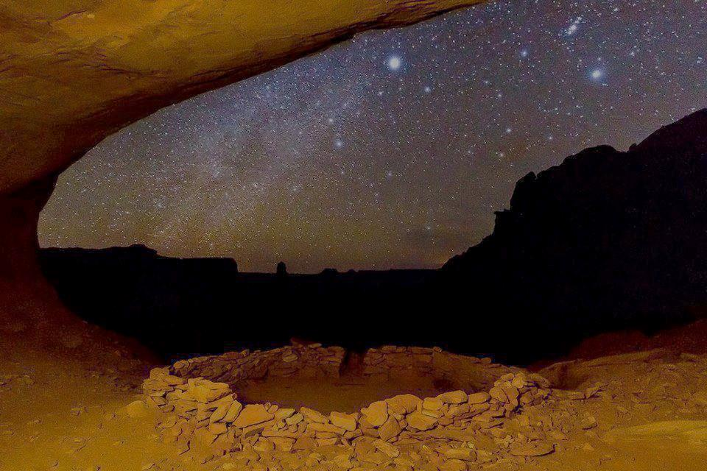
John 5:25 "Most assuredly, I say to you, the hour is coming, and now is, when the dead will hear the voice of the Son of God; and those who hear will live. ²⁶ "For as the Father has life in Himself, so He has granted the Son to have life in Himself, ²⁷ "and has given Him authority to execute judgment also, because He is the Son of Man.

Slide 3
John 5:28 "Do not marvel at this; for the hour is coming in which all who are in the graves will hear His voice ²⁹ "and come forth -- those who have done good, to the resurrection of life, and those who have done evil, to the resurrection of condemnation.

Slide 4
The word resurrection means, “To come back to life after having once died - 'to come back to life, to live again, to be resurrected, resurrection …”(Louw-Nida Lexicon).

Slide 5
. When we die, our spirit leaves our physical body (Jas. 2:26; 1 Kgs 17:21-22) and it goes to the Haden realm (Lk. 16:19-31), which is the waiting place until the Day of Judgment.

Slide 6
Daniel 12:2 And many of those who sleep in the dust of the earth shall awake, Some to everlasting life, Some to shame and everlasting contempt. ³ Those who are wise shall shine Like the brightness of the firmament, And those who turn many to righteousness Like the stars forever and ever.

Slide 7
Revelation 6:9 When He opened the fifth seal, I saw under the altar the souls of those who had been slain for the word of God and for the testimony which they held. ¹⁰ And they cried with a loud voice, saying, "How long, O Lord, holy and true, until You judge and avenge our blood on those who dwell on the earth?" ¹¹ Then a white robe was given to each of them; and it was said to them that they should rest a little while longer, until both the number of their fellow servants and their brethren, who would be killed as they were, was completed.

Slide 8
Acts 24:14 "But this I confess to you, that according to the Way which they call a sect, so I worship the God of my fathers, believing all things which are written in the Law and in the Prophets. ¹⁵ "I have hope in God, which they themselves also accept, that there will be a resurrection of the dead, both of the just and the unjust.

Slide 9
Revelation 20:12 And I saw the dead, small and great, standing before God, and books were opened. And another book was opened, which is the Book of Life. And the dead were judged according to their works, by the things which were written in the books. ¹³ The sea gave up the dead who were in it, and Death and Hades delivered up the dead who were in them. And they were judged, each one according to his works.

Slide 10
1 Corinthians 15: 20 – 28 confirms that Christ was raised from the dead and He is the firstfruits.

Slide 11
1 Corinthians 15: 35 – 49 teaches that our physical bodies will be changed into spiritual bodies that have no corruption, and we will be like Jesus. As:
Philippians 3:20 For our citizenship is in heaven, from which we also eagerly wait for the Savior, the Lord Jesus Christ, ²¹ who will transform our lowly body that it may be conformed to His glorious body, according to the working by which He is able even to subdue all things to Himself.

Slide 12
We do not know what that body will look like because not even the apostle John knew (1 Jn 3:2). However, we do know that the resurrection will happen when Jesus comes again (1 Thes. 4:13-18). The faithful Christians who have already passed from this life will be raised first, and they will come back with Jesus. Then the faithful Christians who are still alive will be transformed, given an incorruptible body and will meet Jesus in the air (1 Cor. 15:50-58).

Slide 13
On that day the just and unjust will be separated and judged (Mt. 25:31- 46), which is also illustrated in Jesus’ parables (Mt. 13). Those who are just will enter heaven where there will be no more pain, death, or sorrow (Rev. 21:4). But the unjust will enter hell for eternity where the worm does not die (Mk. 9:42-48), there is no rest day or night from the torment (Rev. 14:9-11; 20:10), and where there will weeping and gnashing of teeth (Mt. 8:12; 13:42; 25:30).

Slide 14
Matthew 10:28 "And do not fear those who kill the body but cannot kill the soul. But rather fear Him who is able to destroy both soul and body in hell.

Slide 15
Thayer says, “…To devote or give over to eternal misery in hell.”

Slide 16
Our Spirit is given to us by God Zech. 12:1; Heb. 12:9
We live out our short lives, which are like a vapor Jam. 4:14
At Conception
On the Day of Judgment the just and unjust will brought forth from the Haden realm and will be reunited with their new spiritual bodies (Jn. 5:28-29; 1 Cor. 15; Phi. 3:20-21; Rev. 20:12-13) and those living will also be transformed 1 Cor. 15:51-52
The righteous spirit goes to Paradise
Lk. 16:22
At Death the spirit leaves the body (Jam. 2:26) and the body goes into the grave
A great gulf separates them Lk. 16:26
The un-righteous spirit goes to the place of torment Lk. 16:23
On that day the just and unjust will be divided and judged Mat. 25:31-46
The just will be with the Lord in heaven
1 Thes. 4:13-18;
Rev. 21:4; Jn. 14:2-3
The unjust will spend eternity in hell Rev. 14: 9-11; 20:10; Mk. 9:42-40; Mat. 25:46

Slide 17
John 5:30 "I can of Myself do nothing. As I hear, I judge; and My judgment is righteous, because I do not seek My own will but the will of the Father who sent Me. ³¹ " If I bear witness of Myself, My witness is not true. ³² "There is another who bears witness of Me, and I know that the witness which He witnesses of Me is true. ³³ "You have sent to John, and he has borne witness to the truth. ³⁴ "Yet I do not receive testimony from man, but I say these things that you may be saved.

Slide 18
Both the Old and New Testament teach us about using multiple witnesses (Deut. 17:6; 19:15; Mt. 18:16; 2 Cor. 13:1; 1 Tim. 5:19).

Slide 19
John 5:30 "I can of Myself do nothing. As I hear, I judge; and My judgment is righteous, because I do not seek My own will but the will of the Father who sent Me. ³¹ " If I bear witness of Myself, My witness is not true. ³² "There is another who bears witness of Me, and I know that the witness which He witnesses of Me is true. ³³ "You have sent to John, and he has borne witness to the truth. ³⁴ "Yet I do not receive testimony from man, but I say these things that you may be saved.

Slide 20
These Jews who wanted to put Jesus to death had heard the testimony of John the Baptist (Jn. 1:19), and he testified that Jesus was the Christ, the Son of God, the Bridegroom, and the Lamb of God that takes away the sins of the world (Jn. 1:19-35; 3:23-36).

Slide 21
John also said, “He who believes in the Son has everlasting life; and he who does not believe the Son shall not see life, but the wrath of God abides on him” (Jn. 3:36).

Slide 22
John 5:35 "He was the burning and shining lamp, and you were willing for a time to rejoice in his light. ³⁶ "But I have a greater witness than John's; for the works which the Father has given Me to finish -- the very works that I do -- bear witness of Me, that the Father has sent Me. ³⁷ "And the Father Himself, who sent Me, has testified of Me. You have neither heard His voice at any time, nor seen His form.

Slide 23
³⁷ "And the Father Himself, who sent Me, has testified of Me. You have neither heard His voice at any time, nor seen His form.
Verse 37 teaches that the Father has testified of Jesus. He did this verbally on several occasions (Mk. 1:11; 9:7; Jn. 12:28-30).

Slide 24
Based on the context, this is the most logical answer to me especially when we consider the Greek word “akouo”, which is translated “hear”, which means “To hear; to attend to, consider what is or has been said; To understand, perceive the sense of what is said…” (Thayer).

Slide 25
John 5:38 "But you do not have His word abiding in you, because whom He sent, Him you do not believe. ³⁹ "You search the Scriptures, for in them you think you have eternal life; and these are they which testify of Me. ⁴⁰ "But you are not willing to come to Me that you may have life.

Slide 26
John 5:41"I do not receive honor from men. ⁴² "But I know you, that you do not have the love of God in you.

Slide 27
John 5:43 "I have come in My Father's name, and you do not receive Me; if another comes in his own name, him you will receive. ⁴⁴ "How can you believe, who receive honor from one another, and do not seek the honor that comes from the only God?

Slide 28
These Jews loved the praise of men more than the praise of God (Jn. 12:43), which kept some of them from confessing Jesus as Lord even though they believed He was (Jn. 12:42).

Slide 29
That at least sixty-four pretenders to the messiahship had been accepted by the Jews at one time or another, including Bar-Kocheba who deceived the chief officer of the Sanhedrin. Gamaliel, "a doctor of the law," and a man highly honored by the Jews, made mention of deceivers in his day who succeeded in leading many Jews astray (Acts 5:34-37). These men came without authority, and to promote their own honor and they were accepted; Jesus, clothed with authority from the Father, and acting in his name they rejected. Thus, far from being perceptive, they were credulous and easily duped by deceivers because of their love for flattery and worldly praise (Guy N. Woods, A Commentary on the Gospel according to John (Nashville, Tennessee: Gospel Advocate Company, 1987) p.113).

Slide 30
John 5:45 "Do not think that I shall accuse you to the Father; there is one who accuses you -- Moses, in whom you trust. ⁴⁶ "For if you believed Moses, you would believe Me; for he wrote about Me. ⁴⁷ "But if you do not believe his writings, how will you believe My words?"

Slide 31
Deuteronomy 18:15 " The LORD your God will raise up for you a Prophet like me from your midst, from your brethren.

Slide 32
Galatians 3:22 But the Scripture has confined all under sin, that the promise by faith in Jesus Christ might be given to those who believe. ²³ But before faith came, we were kept under guard by the law, kept for the faith which would afterward be revealed. ²⁴ Therefore the law was our tutor to bring us to Christ, that we might be justified by faith. ²⁵ But after faith has come, we are no longer under a tutor.

